Slide 1

DriverPass System Analysis
Matthew Oliphant
Notes:
[No speaker notes required for this slide.]

Slide 2

System Requirements
Functional requirements:
1) The system shall validate user credentials when logging in.
2) The system shall allow customers to purchase driving practice packages (6, 8, or 12 training hours).
Non-Functional requirements:
1) Security
2) Reliability
Notes:
As outlined in the Business Requirements Document, there are many more than two functional and non-functional requirements, but I felt each requirement listed here is important. A functional requirement is something that the system must do, while a non-functional requirement is something that has to be done to the system.
The first functional and non-functional requirements go hand in hand; having users login before accessing the site provides security. All users of this system will expect their data to be secure so that no one else can see it. DriverPass will also use a cloud provider to store user profiles. The cloud will provide additional security as it uses encryption.
The DriverPass system also has to be reliable and available for use at all times. Customers may get frustrated when they are not able to access their account information. The system will allow customers to login to their profile, schedule appointments, and perform several other tasks. When setting up an account, a customer will be shown the available packages for their choosing. This meets DriverPass needs as the customer will purchase a package and pay DriverPass for their services.

Slide 3
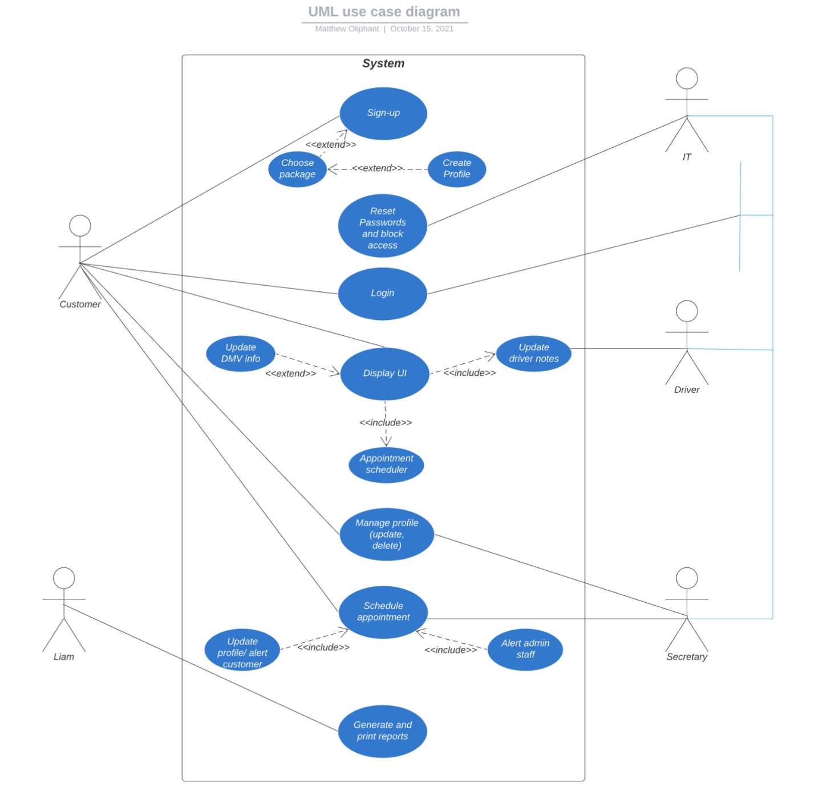
Use Case Diagram
Notes:
This diagram explains a birds-eye view of the DriverPass system. The users of this system include the customer, owner, IT, secretary, and driver. Actions that the users can take include signing up for an account, logging in, resetting passwords, displaying the homepage, displaying the appropriate pages each time a link is clicked, scheduling appointments, managing profiles, and generating/ printing reports.
Many of these actions directly address the needs of DriverPass. Requiring users to login to the system will provide security, while many other actions allow for the customer to use the website without any interruptions. It can be difficult and costly if servers are attacked, so utilizing a cloud provider can nearly guarantee the site will continuously be available.

Slide 4
Activity Diagram
Notes:
This diagram represents the process for a user to login to the DriverPass system. The first step is presented for the user to decide – either sign up or sign in. If the user chooses sign up, they are presented with a registration form to fill out. If they submit valid data, a profile will be created and they can further interact with the system. If the user doesn’t submit valid data, they will be asked to correct the issues.
If the user chooses sign in (already has an account), they will be prompted for their username and password. If the entered credentials match those on file, the user will be taken to their account; otherwise they are directed to try again. DriverPass may implement a feature that locks an account after a certain number of attempts. The user should be able to reset their password.

Slide 5
Security
DriverPass doesn’t allow offline use.
Software uses secure features
Data is encrypted
Data uses safe transmission methods over the internet
User must login to access data (An account is required to interact with the system)
Cloud security measures
Notes:
Every system needs to be prepared against attacks. Since DriverPass is using a cloud provider, the attacks will likely be handled by the cloud provider. Additional measures include the login process described previously. Keeping unauthorized users from the DriverPass system means that only valid users can access the website. Attacks from a user account can be pinpointed and the user blocked. DriverPass will create a secure certificate with user devices so that their data is secure when it’s transmitted from the cloud.
The data will also be encrypted, which provides an additional layer of security. Before data is collected from users, the system is designed to be secure by utilizing object-oriented programming, which is a secure way to write code. Finally, offline use is prohibited which will prevent stale, incorrect data from being displayed. If there was an attempt to update data that’s in this state, the site could crash or lead to other failures, so it’s important to prevent this.

Slide 6
System Limitations
Scalability issue
Time is limited
Budget is limited
Technology is limited
IT cannot modify packages, but can enable/ disable them
Users may have old or outdated technology and may not meet system minimum requirements
Notes:
[What are the limitations of your design? In your explanation, keep your audience in mind by avoiding the use of technical terms.]
Issue growing the company in the long term. It’s considered a failure if admin receives more calls than they can handle. The return on investment wouldn’t justify the website as more secretaries will likely be required, while the site is unused.
Resources will be limited since there are only 10 drivers/ cars. This will limit the number of customers the system can handle. Too many users can mean the drivers are booked months in advance and turn some users away.
Time is limited. DriverPass has a small staff and IT can only dedicate so much time to fixing issues. Customers may have to wait longer than they desire for issues to be resolved.
Technology is limited for IT. Using the cloud will remove a lot of technical work, but also requires some. IT will not be able to control the system as much as they would if the server was kept “in-house.”
Users must be online to access the system.

